Slide 1
ECOMMERCE WEB APPLICATION
Sprint-1 Presentation
Presented by
Kalyani Choudhary

Slide 2
Contents:
Introduction
Working Structure (Block diagram)
Features
UI output

Slide 3
Introduction
Ecommerce website that allows you to buy and sell tangible goods, digital products or services online.
E-Commerce websites are online portals that facilitate online transactions of goods and services through means of the transfer of information and funds over the Internet.

Slide 4
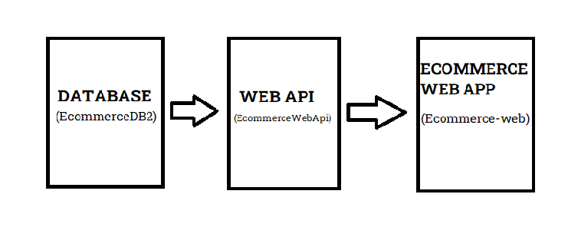
Working Structure:

Slide 5
Features:
User Section (Customer Section):
User can register and login
User can purchase product
User can see the product
Admin Section:
Admin can login and add categories
can see all orders placed by the customer and customer details
admin can add products

Slide 6
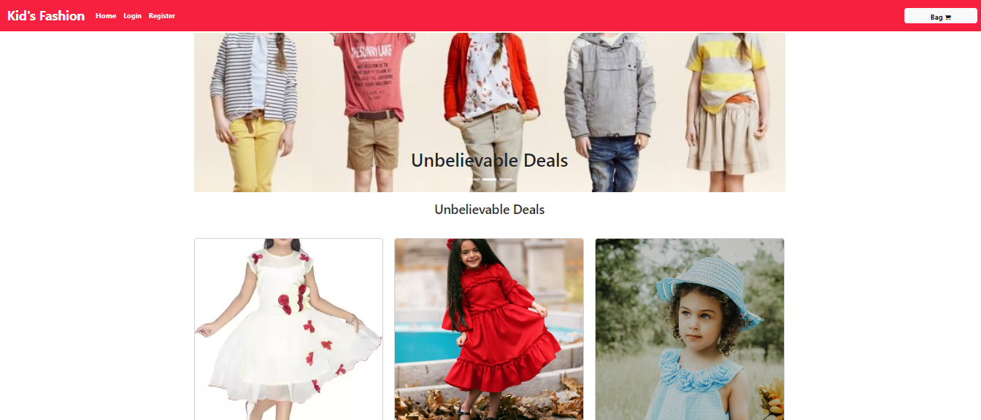
UI Output:

Slide 7
Thank You

